Slide 1
PE PROPER
TWO-MINUTE PRODUCT TOUR
Divide the property.
19
See the balance.
fictional assets
Document the agreement.
$17,860
current FMV
One organized matter from household inventory to professional report.
01
Notes:
[Timing] 0:00–0:12
Dividing household property is not only about listing belongings. Every item affects the financial balance and the final agreement.
[Sources]
- Original visualization and fictional demonstration data prepared for this tour.

Slide 2
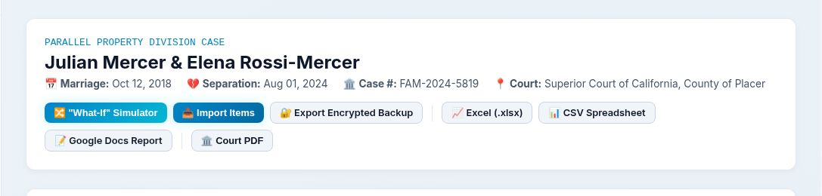
PE PROPER
CREATE THE MATTER
Start with the relationship and the court matter
A concise case record anchors every item, participant, calculation, and output.
MARRIED
SEPARATED
DURATION
MATTER
Oct 12, 2018
Aug 1, 2024
5.8 years
FAM-2024-5819
02
Notes:
[Timing] 0:12–0:25
Enter the spouses, marriage and separation dates, case number, and court. The fictional Mercer matter spans approximately 5.8 years.
[Sources]
- PE Proper test environment, fictional case header, accessed July 27, 2026.

Slide 3
PE PROPER
INVITE PARTICIPANTS
Build one inventory together
Role-specific links and QR access let participants catalog remotely while preserving attribution.
1
2
3
SPOUSE A
SPOUSE B
PROFESSIONAL
Julian
Elena
Mediator / counsel
Assigned access • attributed entries
Assigned access • attributed entries
Assigned access • attributed entries
Separate entry points → one shared matter
03
Notes:
[Timing] 0:25–0:42
Use assigned links or QR codes so each spouse or professional can catalog from a phone or computer. Entries stay connected to the matter and can retain participant attribution.
[Sources]
- PE Proper public feature and hands-on workflow review, accessed July 27, 2026.

Slide 4
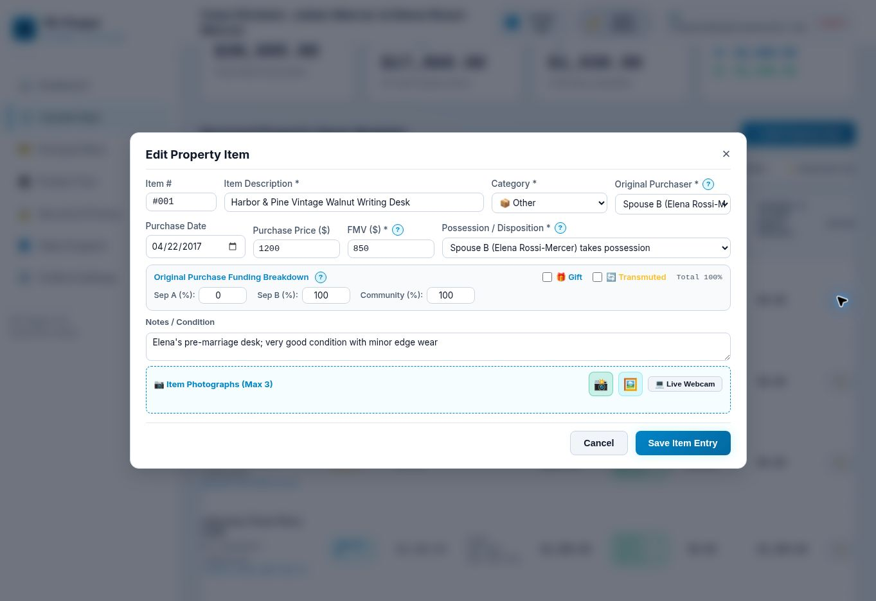
PE PROPER
ADD COMPLETE PROPERTY RECORDS
Turn every object into a decision record
Description, ownership history, funding, value, condition, disposition, and photographs stay together.
✓
What it is
✓
When it was bought
✓
Who bought it
✓
How it was funded
✓
What it is worth now
✓
Who keeps it—or sell 50/50
04
Notes:
[Timing] 0:42–1:02
Capture the description, category, purchaser, purchase date, original price, current fair-market value, funding percentages, final disposition, notes, and photographs. Each asset becomes a complete, reviewable decision record.
[Sources]
- PE Proper test environment, add-property dialog, accessed July 27, 2026.

Slide 5
PE PROPER
SEE THE LIVE BALANCE
Nineteen decisions become one visible financial picture
The demonstration matter recalculated as each item was classified and allocated.
19
$38,695
$17,860
$1,030
ASSETS
ORIGINAL PURCHASE VALUE
CURRENT FAIR-MARKET VALUE
GIFTS • 2 ITEMS
Julian
$9,080
Elena
$8,780
$740 equalization payment → Elena
05
Notes:
[Timing] 1:02–1:18
Watch fair-market values, gifts, separate funds, spouse allocations, and the equalization payment update. In this fictional matter, the current fair-market value is seventeen thousand eight hundred sixty dollars, with a seven-hundred-forty-dollar payment from Julian to Elena.
[Sources]
- Calculations observed in the PE Proper fictional demonstration matter on July 27, 2026.

Slide 6
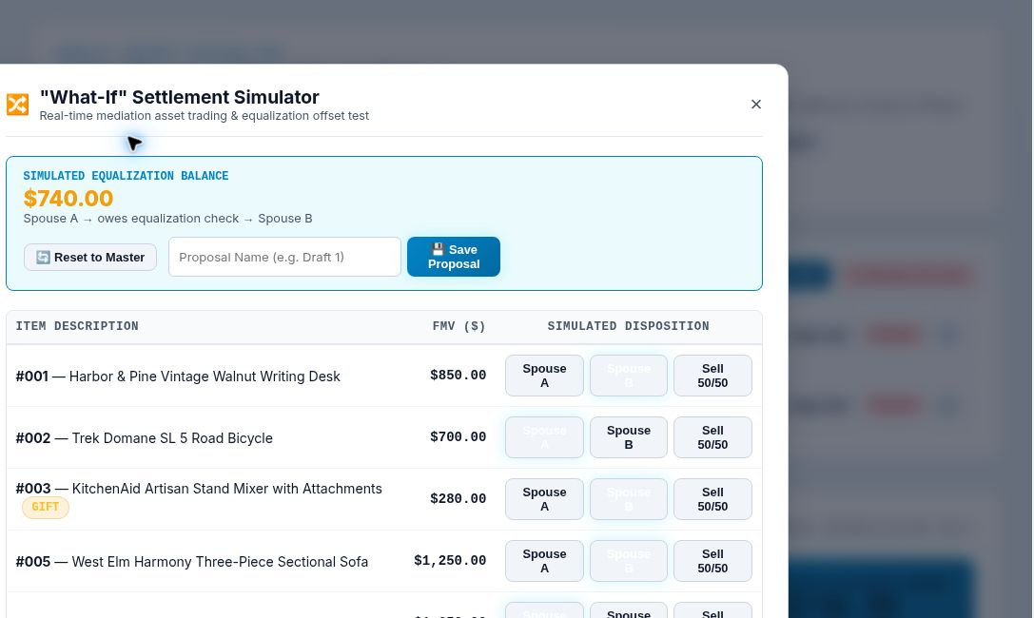
PE PROPER
TEST SETTLEMENT OPTIONS
Explore trades without disturbing the master record
Reassign an asset or sell it 50/50, then watch the simulated balance respond.
$740
simulated equalization
Spouse A
Spouse B
Sell 50/50
06
Notes:
[Timing] 1:18–1:34
Trade items between spouses or designate sale proceeds fifty-fifty in the What-If Simulator. The simulated equalization changes without altering the master inventory until a proposal is intentionally saved.
[Sources]
- PE Proper test environment, What-If Settlement Simulator, accessed July 27, 2026.

Slide 7
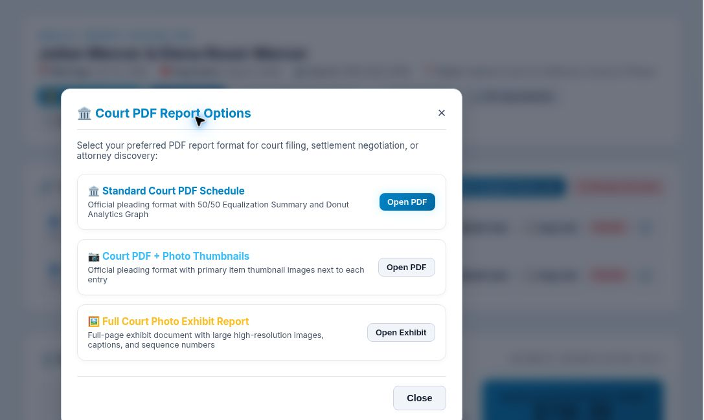
PE PROPER
GENERATE PROFESSIONAL OUTPUTS
Move from negotiation to a useful handoff
Choose a court schedule, thumbnail schedule, photo exhibit, spreadsheet, document report, or encrypted backup.
COURT
Standard schedule
PHOTOS
Thumbnail or full exhibit
DATA
Excel and CSV
BACKUP
Encrypted archive
07
Notes:
[Timing] 1:34–1:44
Open a court schedule, photo exhibit, spreadsheet, document report, or encrypted backup. The same property records can support negotiation, review, and filing preparation.
[Sources]
- PE Proper test environment, court-report options, accessed July 27, 2026.

Slide 8
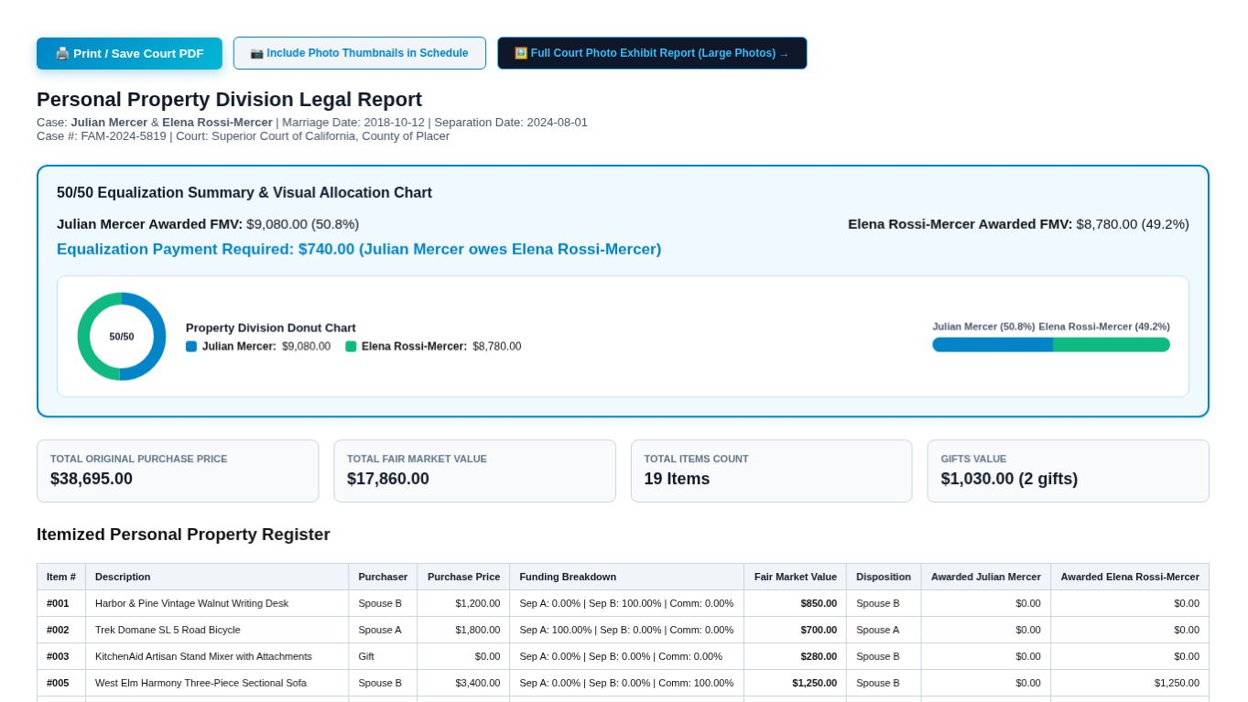
PE PROPER
REPORT-READY MATTER
The outcome is visible at a glance
A professional report connects the equalization summary, case metrics, and itemized property register.
50.8%
Julian
49.2%
Elena
08
Notes:
[Timing] 1:44–1:50
The generated report connects the equalization summary, case metrics, and itemized register in one reviewable handoff.
[Sources]
- PE Proper test environment, generated fictional court report, accessed July 27, 2026.

Slide 9
PE PROPER
A CLEARER PATH TO AGREEMENT
One organized matter.
One visible balance.
A clearer path to agreement.
1
CAPTURE
2
CLASSIFY
3
NEGOTIATE
4
EXPORT
PE Proper
Property organization and calculation software—not legal advice.
09
Notes:
[Timing] 1:50–2:00
One organized matter. One visible balance. A clearer path to agreement. PE Proper brings capture, classification, negotiation, and professional reporting into one focused workflow.
[Sources]
- Original visualization and fictional demonstration data prepared for this tour.

